Slide 1
Course title:
Web Development
Let’s build a web app from scratch!!
Farhan Daemi

Slide 2
Question 1: What is…
Front-end

Slide 3
Question 2: What is…
Back-end

Slide 4
Question 3: What is…
Database

Slide 5
Question 4: What is…
API

Slide 6
Question 5: What is…
Server

Slide 7
Mini challenge: Find your local
IP-Address
You can use ipconfig command in your terminal

Slide 8
HTML </>
Hyper text markup language

Slide 9
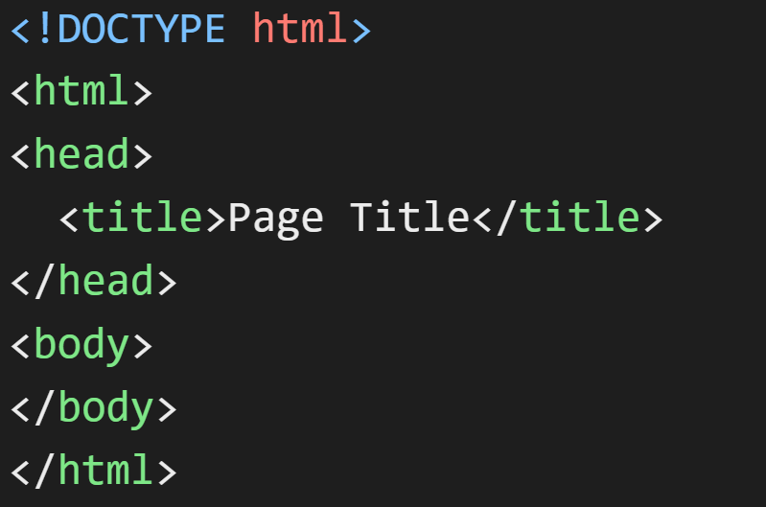

Slide 10
<html> — whole HTML document
<head> — hidden info about the page
<title> — browser tab title
<body> — visible part of the page

Slide 11
<h1> to <h6> — headings
<p> — paragraph
<br> — line break
<strong> — important text
<b> — bold text
<em> — emphasized text
<i> — italic text
<span> — small inline text container
<a> — link
<img> — image

Slide 12
<ul> — unordered list
<li> — list item
<div> — block container
<section> — section of a page
<header> — top area
<footer> — bottom area
<nav> — navigation menu
<main> — main content
<article> — independent content

Slide 13
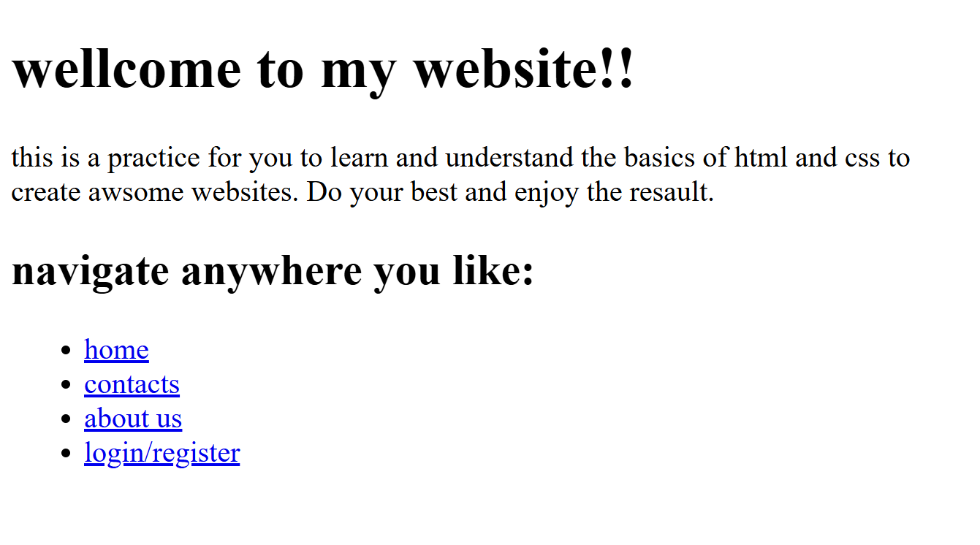
Practice 1: build this web page using HTML

Slide 14
<form> — form container
<input> — input field
<label> — text label for input
<button> — button
<textarea> — large text input
<select> — dropdown
<option> — dropdown option

Slide 15
<table> — table
<tr> — table row
<th> — table header
<td> — table cell

Slide 16
CSS </>
Cascading Style Sheet

Slide 17
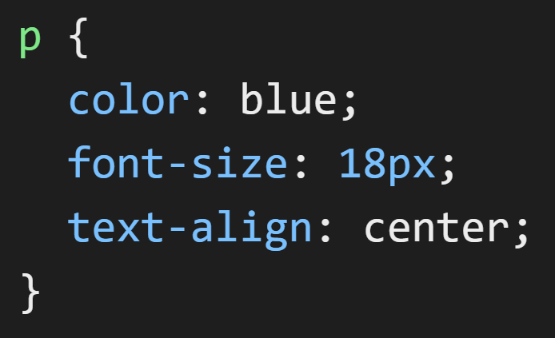

Slide 18
color — text color
font-size — text size
font-family — font type
font-weight — boldness
text-align — left, center, right
text-decoration — underline, none
line-height — line spacing

Slide 19
background-color — background color
background-image — background picture
background-size — size of background
background-position — background position

Slide 20
width — width
height — height
margin — outer space
padding — inner space
border — border around element
border-radius — rounded corners

Slide 21
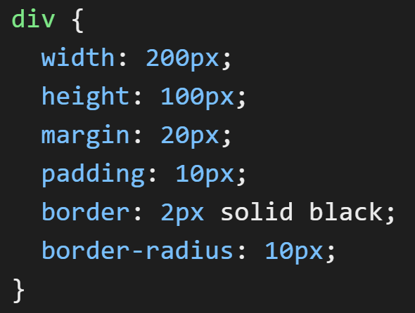

Slide 22
display — how an element behaves
Block
Inline
inline-block
Flex
Grid
position — positioning method
top, right, bottom, left
z-index — layer order

Slide 23
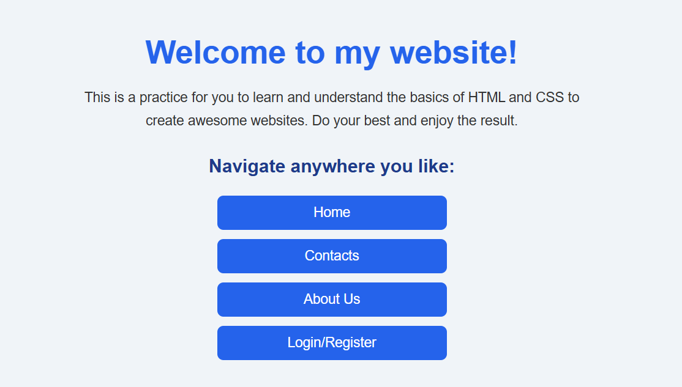
Practice 2: Make your HTML code beautiful with CSS

Slide 24
Node.js </>
a tool that allows us to run JavaScript outside the browser.

Slide 25
With Node.js
JavaScript can create servers
JavaScript can work with files
JavaScript can connect to databases
JavaScript can build backend applications

Slide 26
So instead of only making webpages, we can now build full applications using JavaScript.

Slide 27
Why is Node.js used?
Node.js is popular because it is:
Fast
Easy to learn for web developers
Great for web servers
Good for real-time apps like chats and games

Slide 28
How does Node.js run JavaScript outside the browser?
Normally The browser has a JavaScript engine
Node.js includes its own JavaScript engine called:
V8 Engine
the same engine used in Google Chrome

Slide 29
This means Node.js can run JavaScript directly on your computer without needing a browser.

Slide 30
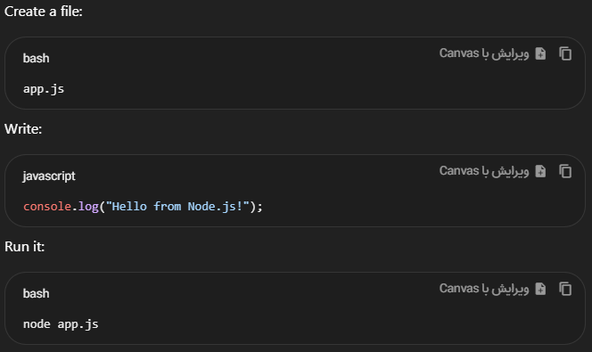
First Node.js Example:

Slide 31
Front-end
Back-end
What users see:
HTML
CSS
Browser JavaScript
What runs on the server:
Databases
Authentication
APIs
Server logic

Slide 32
Imagine a restaurant:
Front-end
Back-end
The dining area:
Tables
Menu
Decorations
The kitchen:
Cooking food
Preparing orders
Managing ingredients

Slide 33
npm </>
Node Package Manager

Slide 34
What is npm?
Think of npm like the App Store or Google Play Store on your phone:
Instead of downloading games or apps, developers use npm to download pre-written code.
It comes automatically installed when you install Node.js.

Slide 35
What is a Package?
A package (also called a module or library) is code written by other programmers that you can freely use in your own projects so…
you don’t have to build everything from scratch!

Slide 36
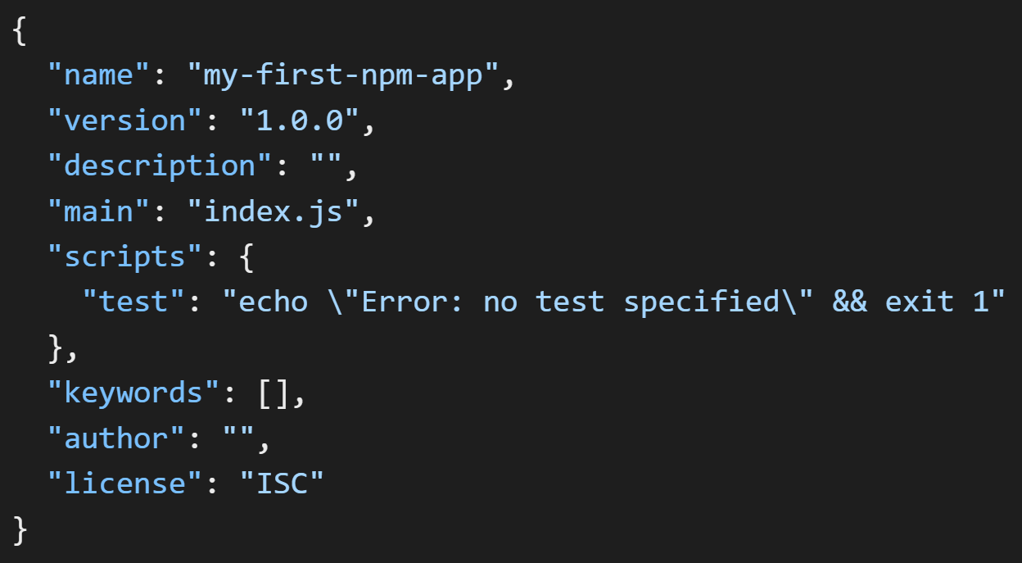
Package.json

Slide 37
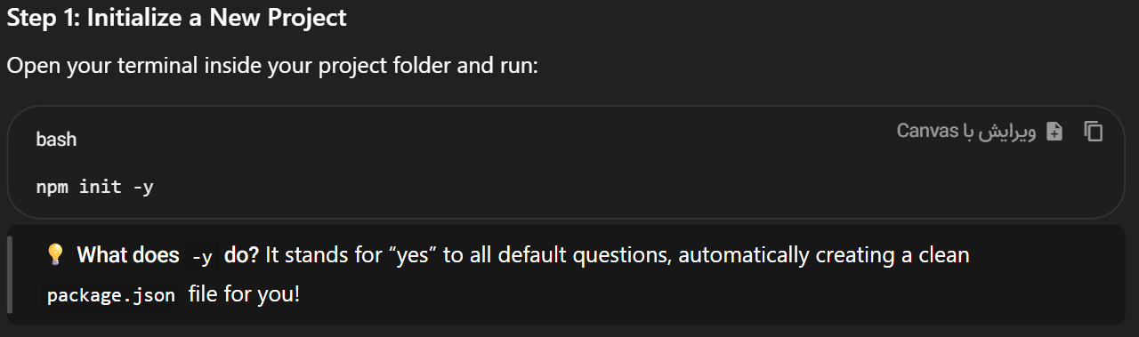

Slide 38
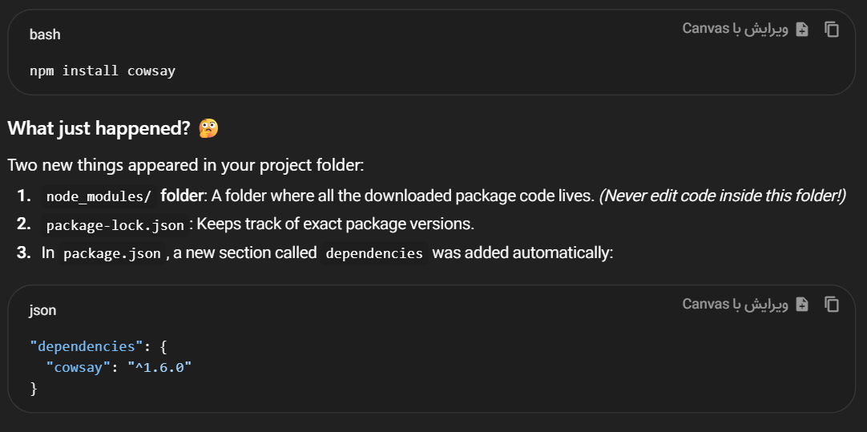

Slide 39
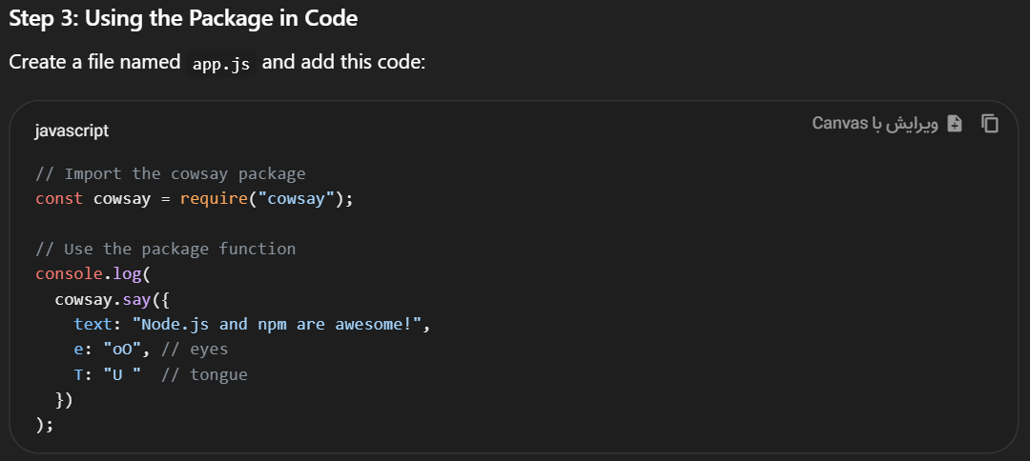

Slide 40
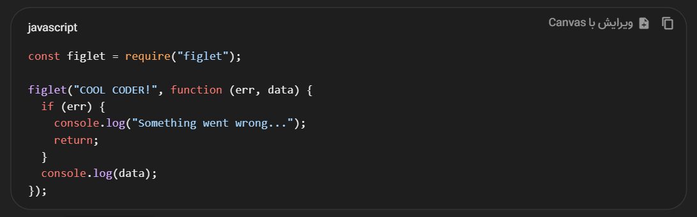
Practice 3: install figlet using npm and run this code!!

Slide 41
Express.js </>
a Node.js package that helps us create web servers

Slide 42
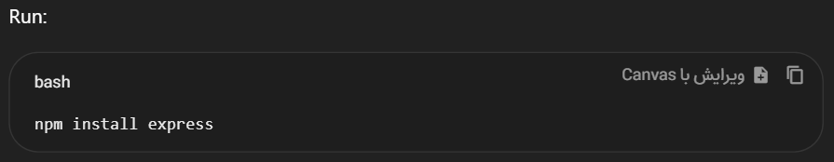
Install Express.js

Slide 43
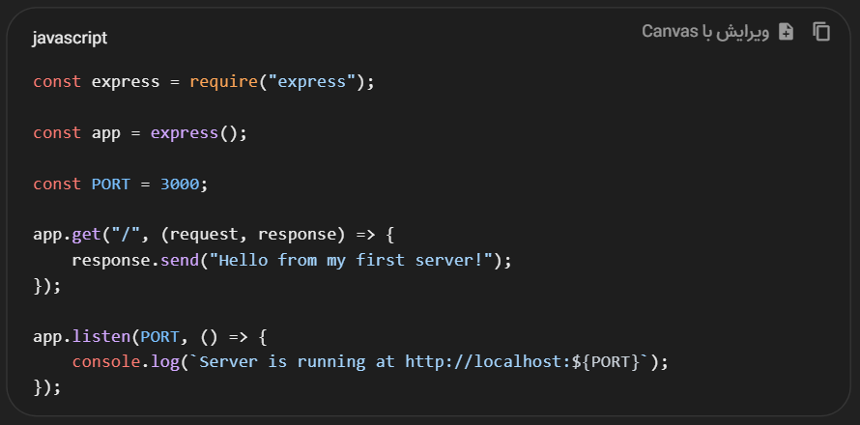
Write the server code

Slide 44
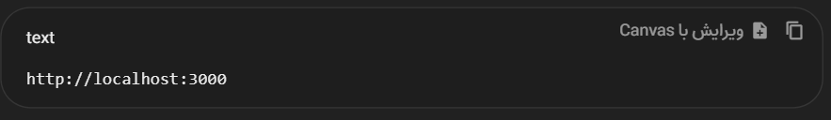
Open in your browser:

Slide 45
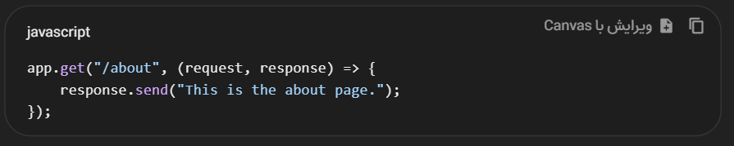
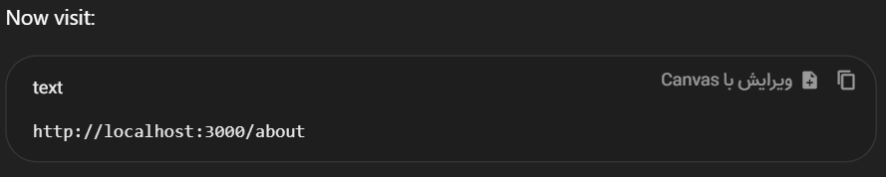
Add a second page:

Slide 46
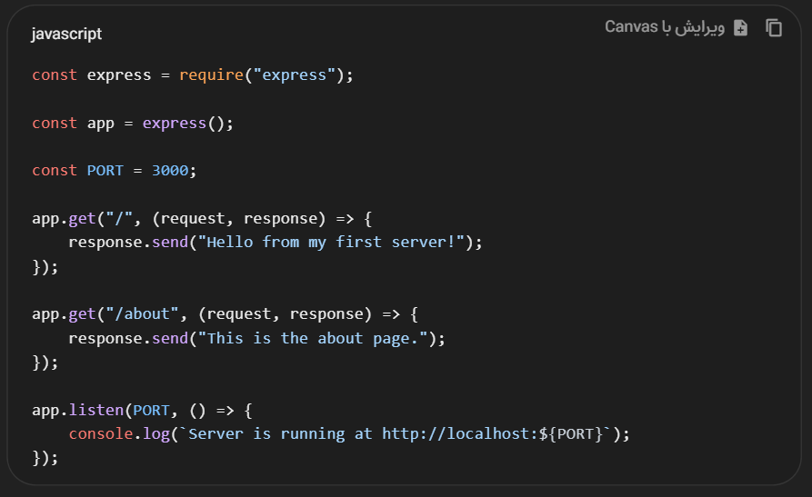

Slide 47
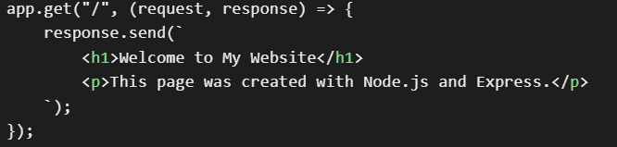
Add HTML response:

Slide 48
EJS </>
Template Engine
a template engine that lets you embed JavaScript code directly inside HTML files

Slide 49
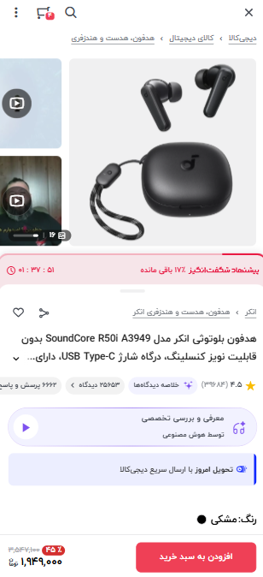
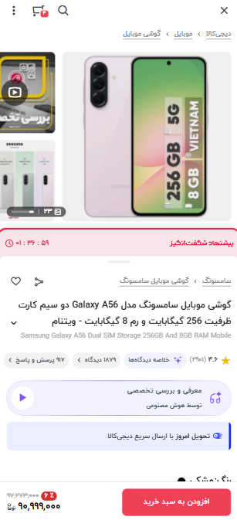
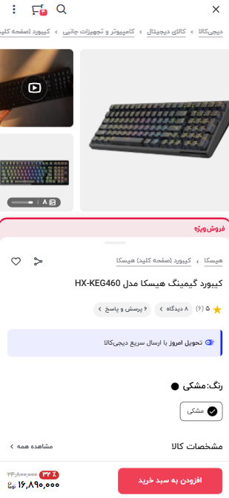

Slide 50
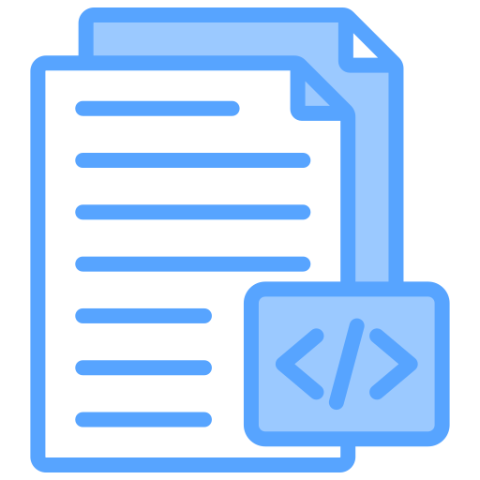
headphone.HTML
phone.HTML
keyboard.HTML

Slide 51
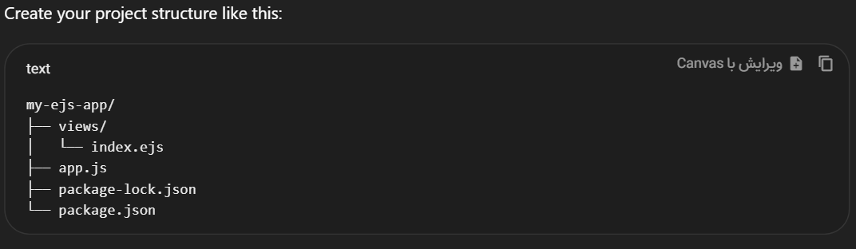

Slide 52
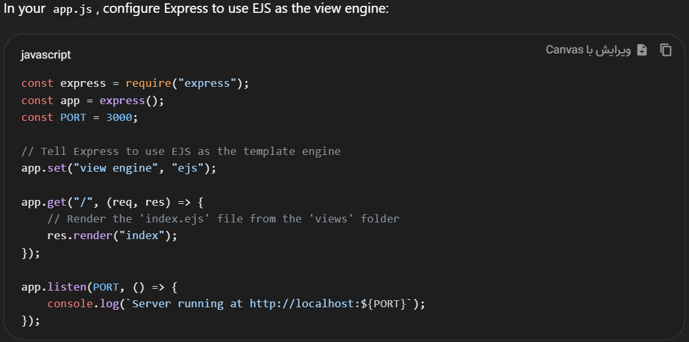

Slide 53
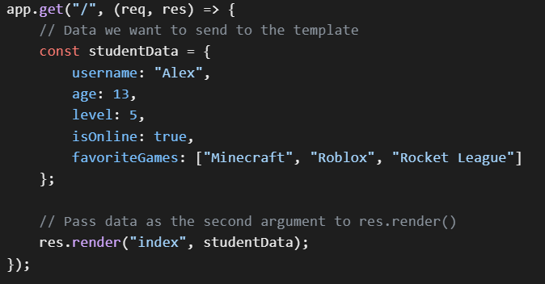
Passing data from server to page

Slide 54
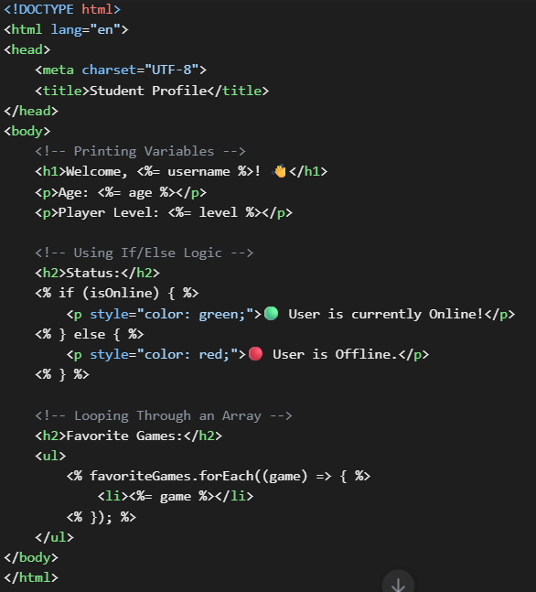

Slide 55
Adding a
Public folder
The public folder stores files that the browser is allowed to access directly.

Slide 56
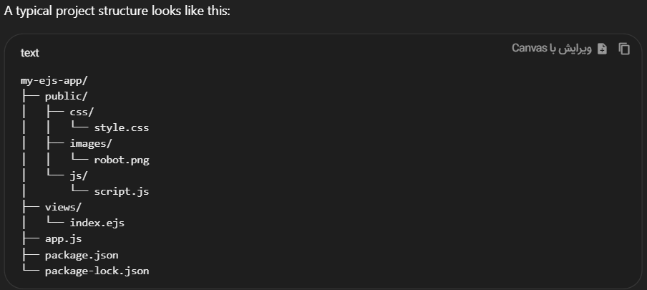

Slide 57
